Slide 1
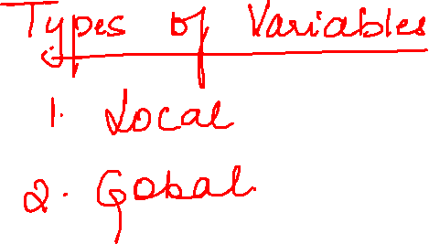

Slide 2
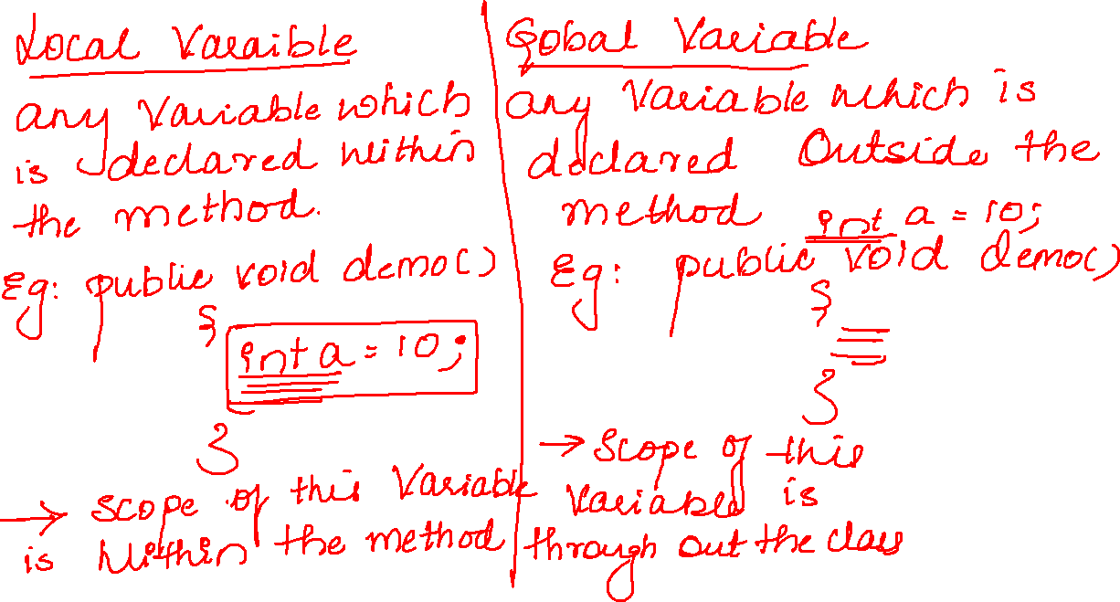

Slide 3
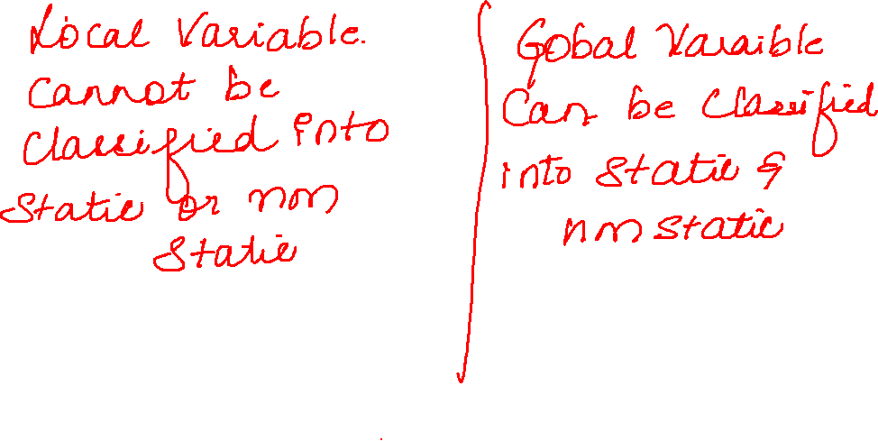

Slide 4
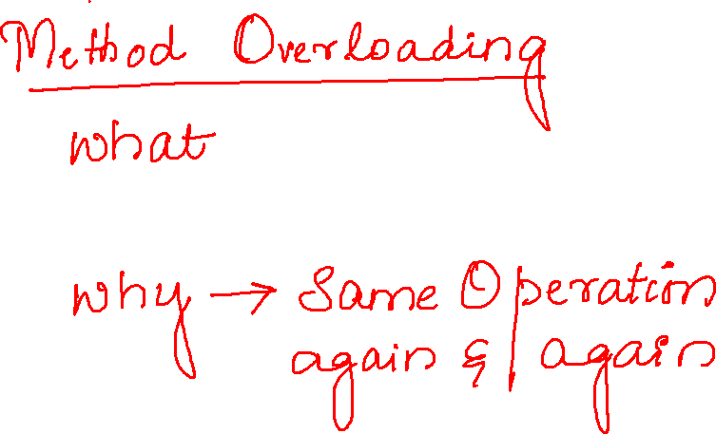

Slide 5


Slide 6


Slide 7
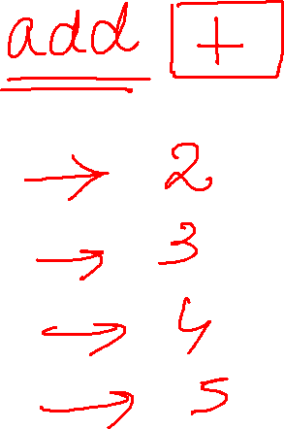

Slide 8
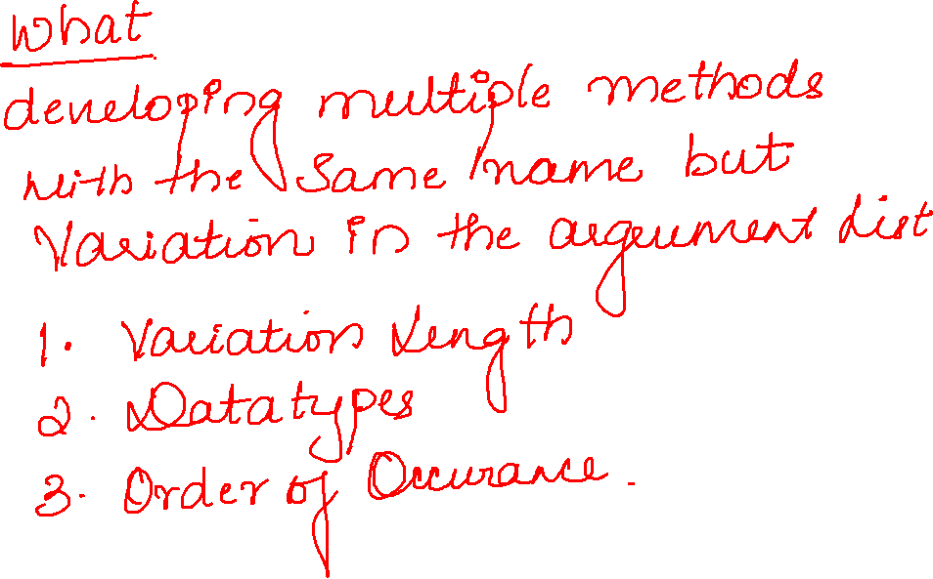

Slide 9
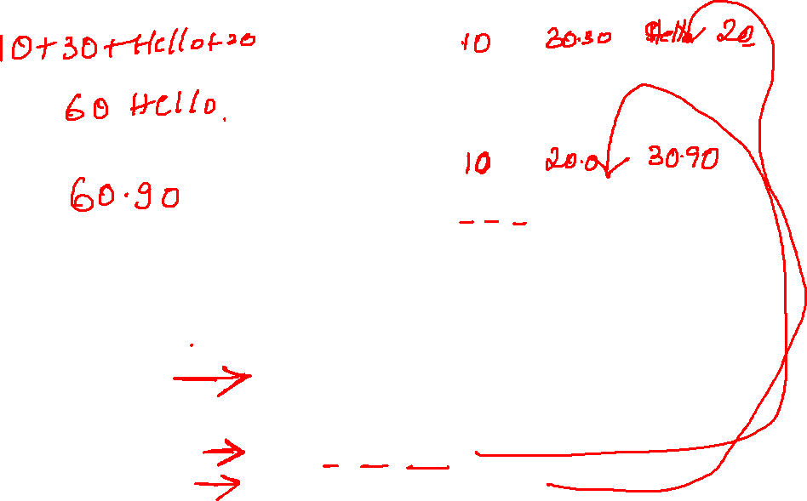
public class Test8 {
public void add(int a,int b) {
System.out.println(a+b);
}
public void add(int a,double b,String c,int d) {
System.out.println(a+b+c+d);
}
public void add(int a,double b,double c) {
System.out.println(a+b+c);
}
public void add(double a,double b,int c) {
System.out.println(a+b+c);
}
public static void main(String[] args) {
Test8 t=new Test8();
t.add(10,20.0,30.90);
t.add(10,30.0,"Hello",20);
}

Slide 11
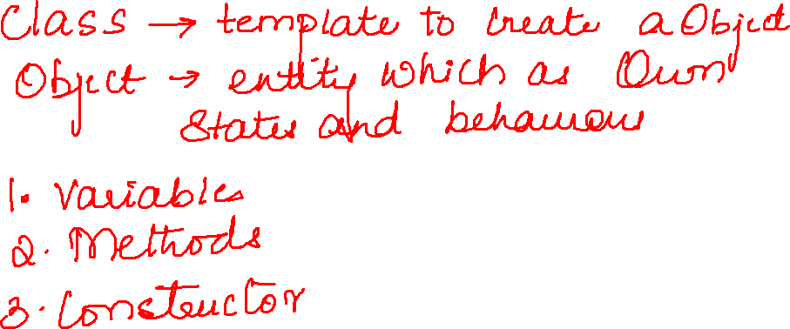

Slide 12
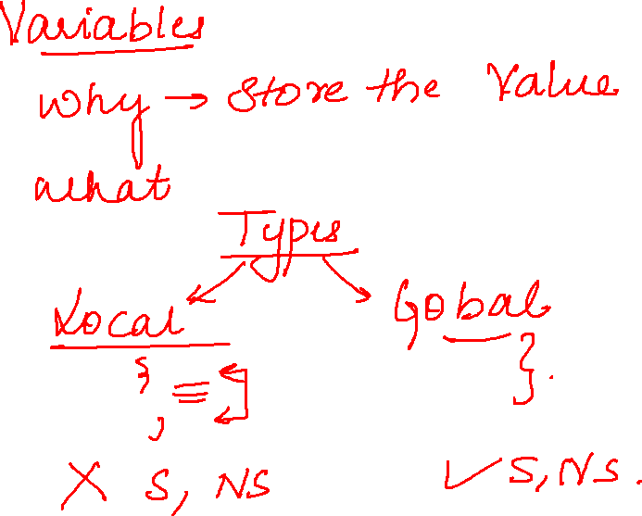

Slide 13
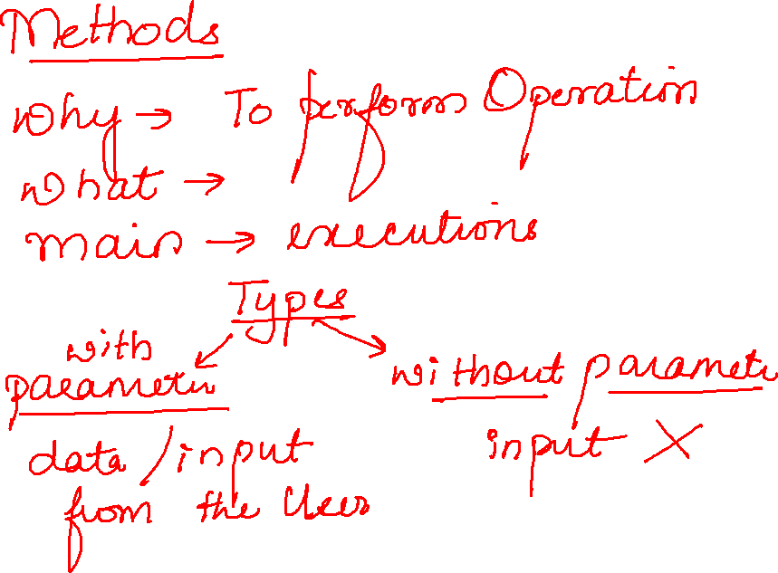

Slide 14
